Slide 1
Edge NodeJS
Packaging and Deployment

Slide 2
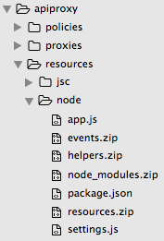
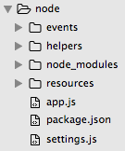
NodeJS deployment considerations
All files in root directory copied under /resources/node
All folders compressed and copied under /resources/node
Notes:
You can implement your Node.js code in any folder you want – this is independent of Apigee. But when you come to deploy your implementation to Apigee, copy all files in your root folder to /apiproxy/resources/node folder and zip each folder in your implementation and copy each zip to /apiproxy/resources/node.
As the size of the Node.js implementation increases, the bundle that needs to be uploaded to Apigee Edge increases.
The main culprit in most scenarios is the node_modules folder which contains all the modules installed for the project via NPM. This may bloat the size of the bundle a lot and causes delays during deployment.

Slide 3
Deployment tools
Management UI
Create a new API proxy with Node.js support and edit Node.js code
Deploy/save via Management UI
Shell scripting
Like everything in Apigee, importing and deployment of bundles are exposed as API calls
Manually copying/zipping Node.js files/folders and executing management API calls to deploy bundle
http://apigee.com/docs/api-services/content/deploying-proxies-command-line

Slide 4
Deployment tools
apigeetool for Node.js deployment
Zips installed modules and directories deploys them with the bundle
http://apigee.com/docs/api-services/content/deploying-standalone-nodejs-app
Maven
Using Apigee Maven Plugin
https://github.com/apigee/apigee-deploy-maven-plugin
$ sudo npm install -g apigeetool
$ apigeetool deploynodeapp
-n {proxyname}
-o {org}
-e {env}
-b {/your/proxy/basepath}
-d {./relative_or_absolute/path/to/node/app/on/local/machine}
-m {nameOfServer.js}
-u {enterprise_email@example.com}
-p {password}

Slide 5
Caveats
You cannot edit files in these zipped directories on the Edge management UI's editor. If you need to change them, you can export your project, edit the files locally, and then redeploy.
Installed modules (node_modules) can be very big in size – which will present problems during import, export or extraction of the bundle
Solution
use Management API to execute NPM commands for an API proxy deployed on Apigee Edge.
http://apigee.com/docs/management/apis/post/organizations/%7Borg_name%7D/apis/%7Bapi_name%7D/revisions/%7Brevision_num%7D/npm

Slide 6
THANK YOU

